Slide 1
Exploring factors to increase sales
09/16/2019
Yeonjoo Smith

Slide 2
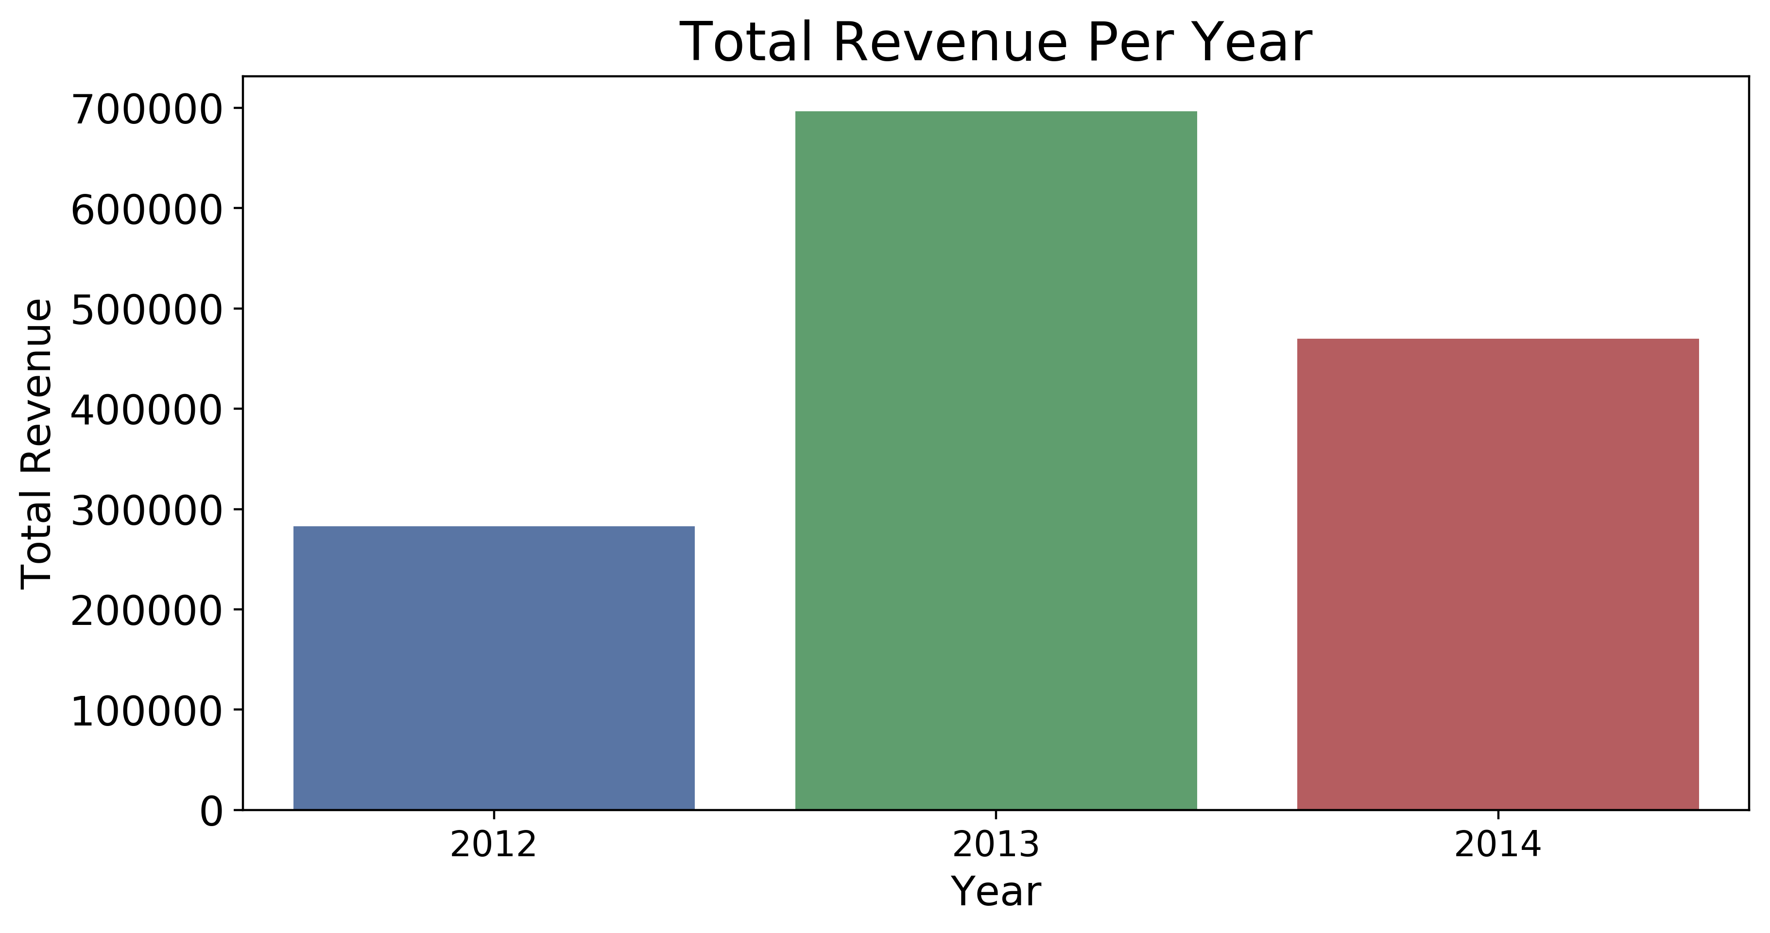
Motivation: Total Revenue Change Over Years
Finding factors that affect total revenue
Total spending per order
Quantity per order
Customer retention rate
Orders per client in a year
Suggestion
Discounts

Slide 3
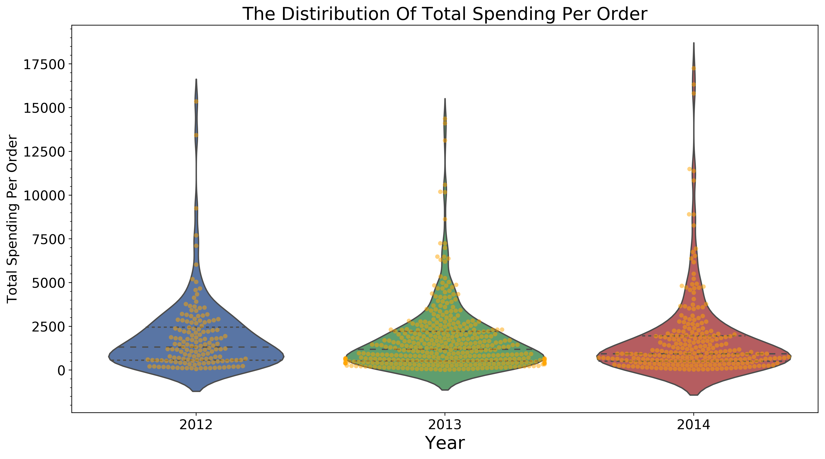
Total Spending per Order: Do customers spend more/less per order?
Average spending per each order
In 2012:$1862
In 2013:$1707
In 2014:$1740
ANOVA testing result
Not significant
Amount of spending per order stayed consistent!

Slide 4
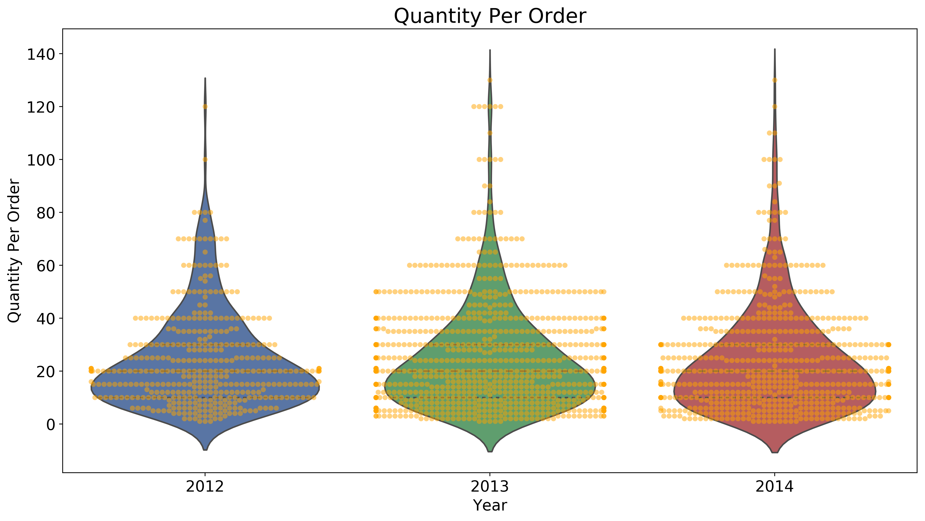
Quantity per Order: Do customers order more/less quantity of a product per order?
Average quantity per each order
In 2012: 23.66 units
In 2013: 24.07 units
In 2014:23.5 units
ANOVA testing result
Not significant
Amount of quantity per order stayed consistent!

Slide 5
New Customers and Retention Rate
Answer for rapid revenue increase in 2013!
New customers:
In 2013: 19
In 2014:13
Retention rate:
In 2013:98%
In 2014: 100%
AWESOME!
But… What about the decrease in revenue for 2014?

Slide 6
Frequency of Orders
Average orders per client in a year
In 2012:1.73 times
In 2013: 4.69 times
In 2014:3.33 times
ANOVA test
SIGNIFICANT!!
The order frequency has changed!
To Check the change from 2013 to 2014:
Welch’s t-test
Customers shopped less frequently in 2014!

Slide 7
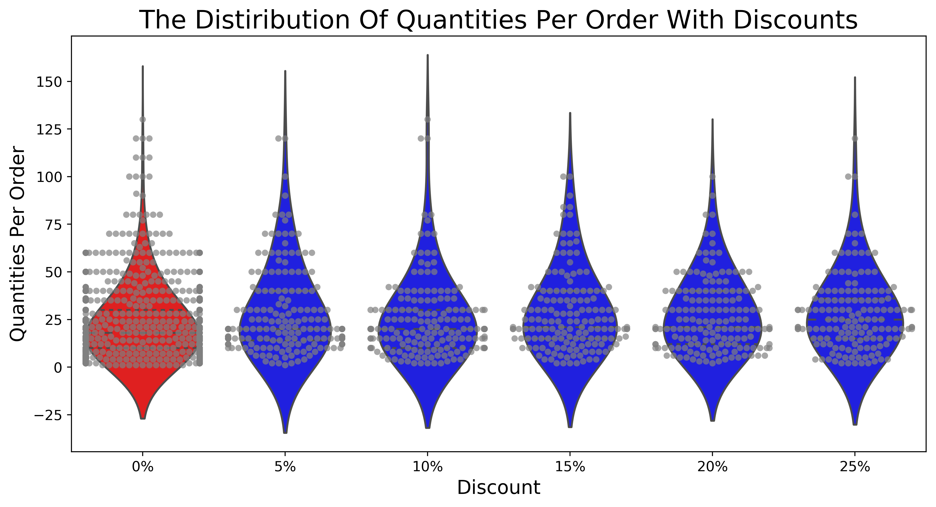
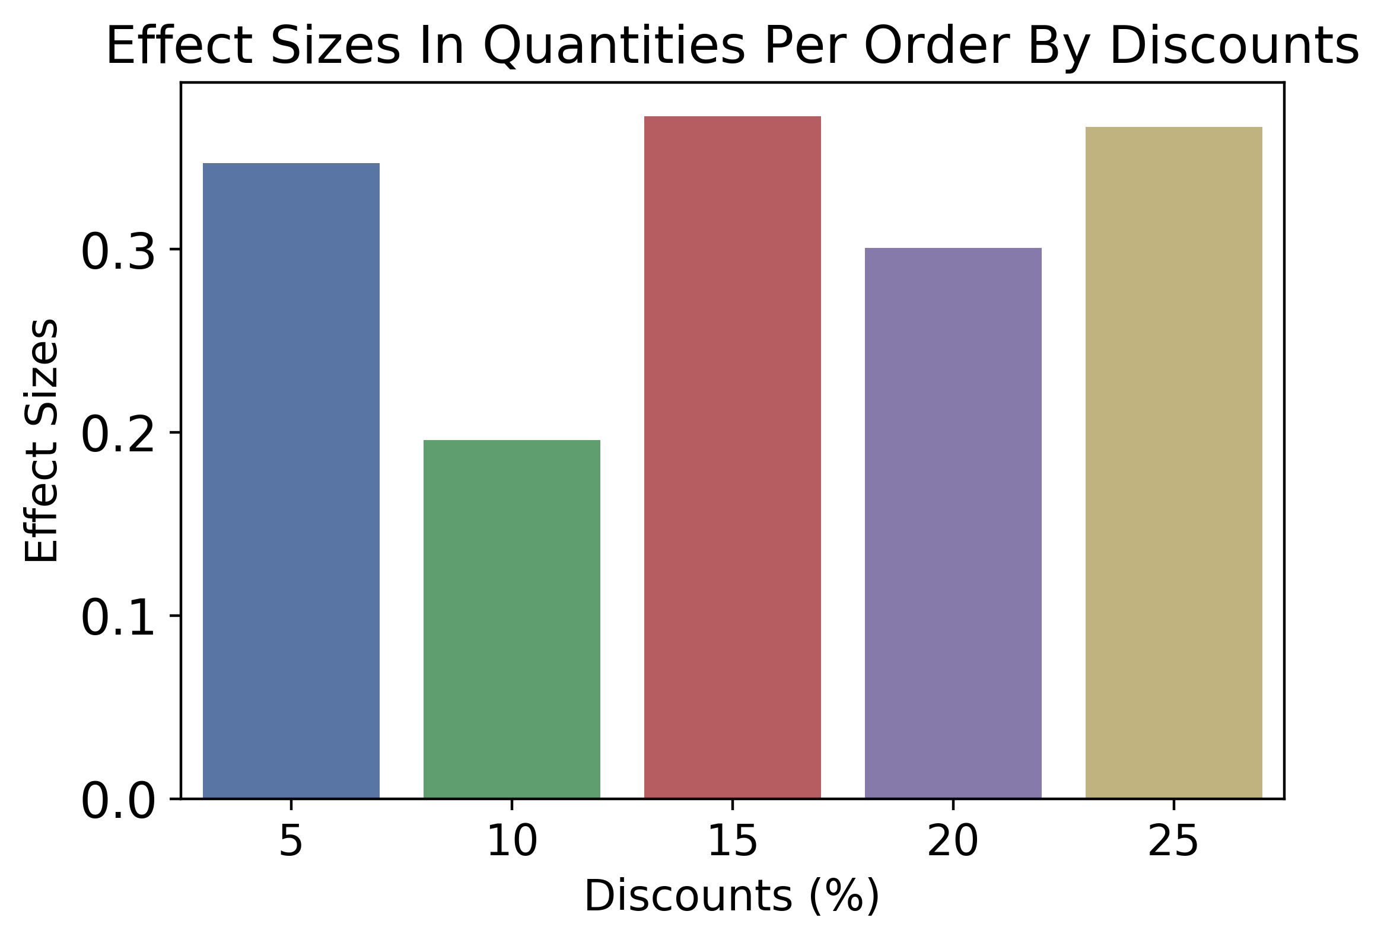
Do discounts make people buy more in general?
Average quantity per order:
0%:21.72 units
5% :28 units
15%:28.38 units
25%28.24 units
ANOVA test
SIGNIFICANT !!
The quantity per order increase with ANY discount!!
14% would order 6 more!

Slide 8
Summary
Total revenue increase in 2013
Increase of new customers in 2013
Total revenue decrease in 2014
Insignificant:
Total spending per order
Quantity per order
100% retention rate
Significant:
Frequency of orders per customer
Suggestion: Discount
Quantity in a order increase with discounts
Give 5% discount

Slide 9
Suggestions for further investigation
Factors that drive new clients in 2013
Ideas for increasing frequency of orders such as coupons or events
Factors that lower order counts
Shipping process time
Sales divided into category
Sales divided into different regions

